Slide 1
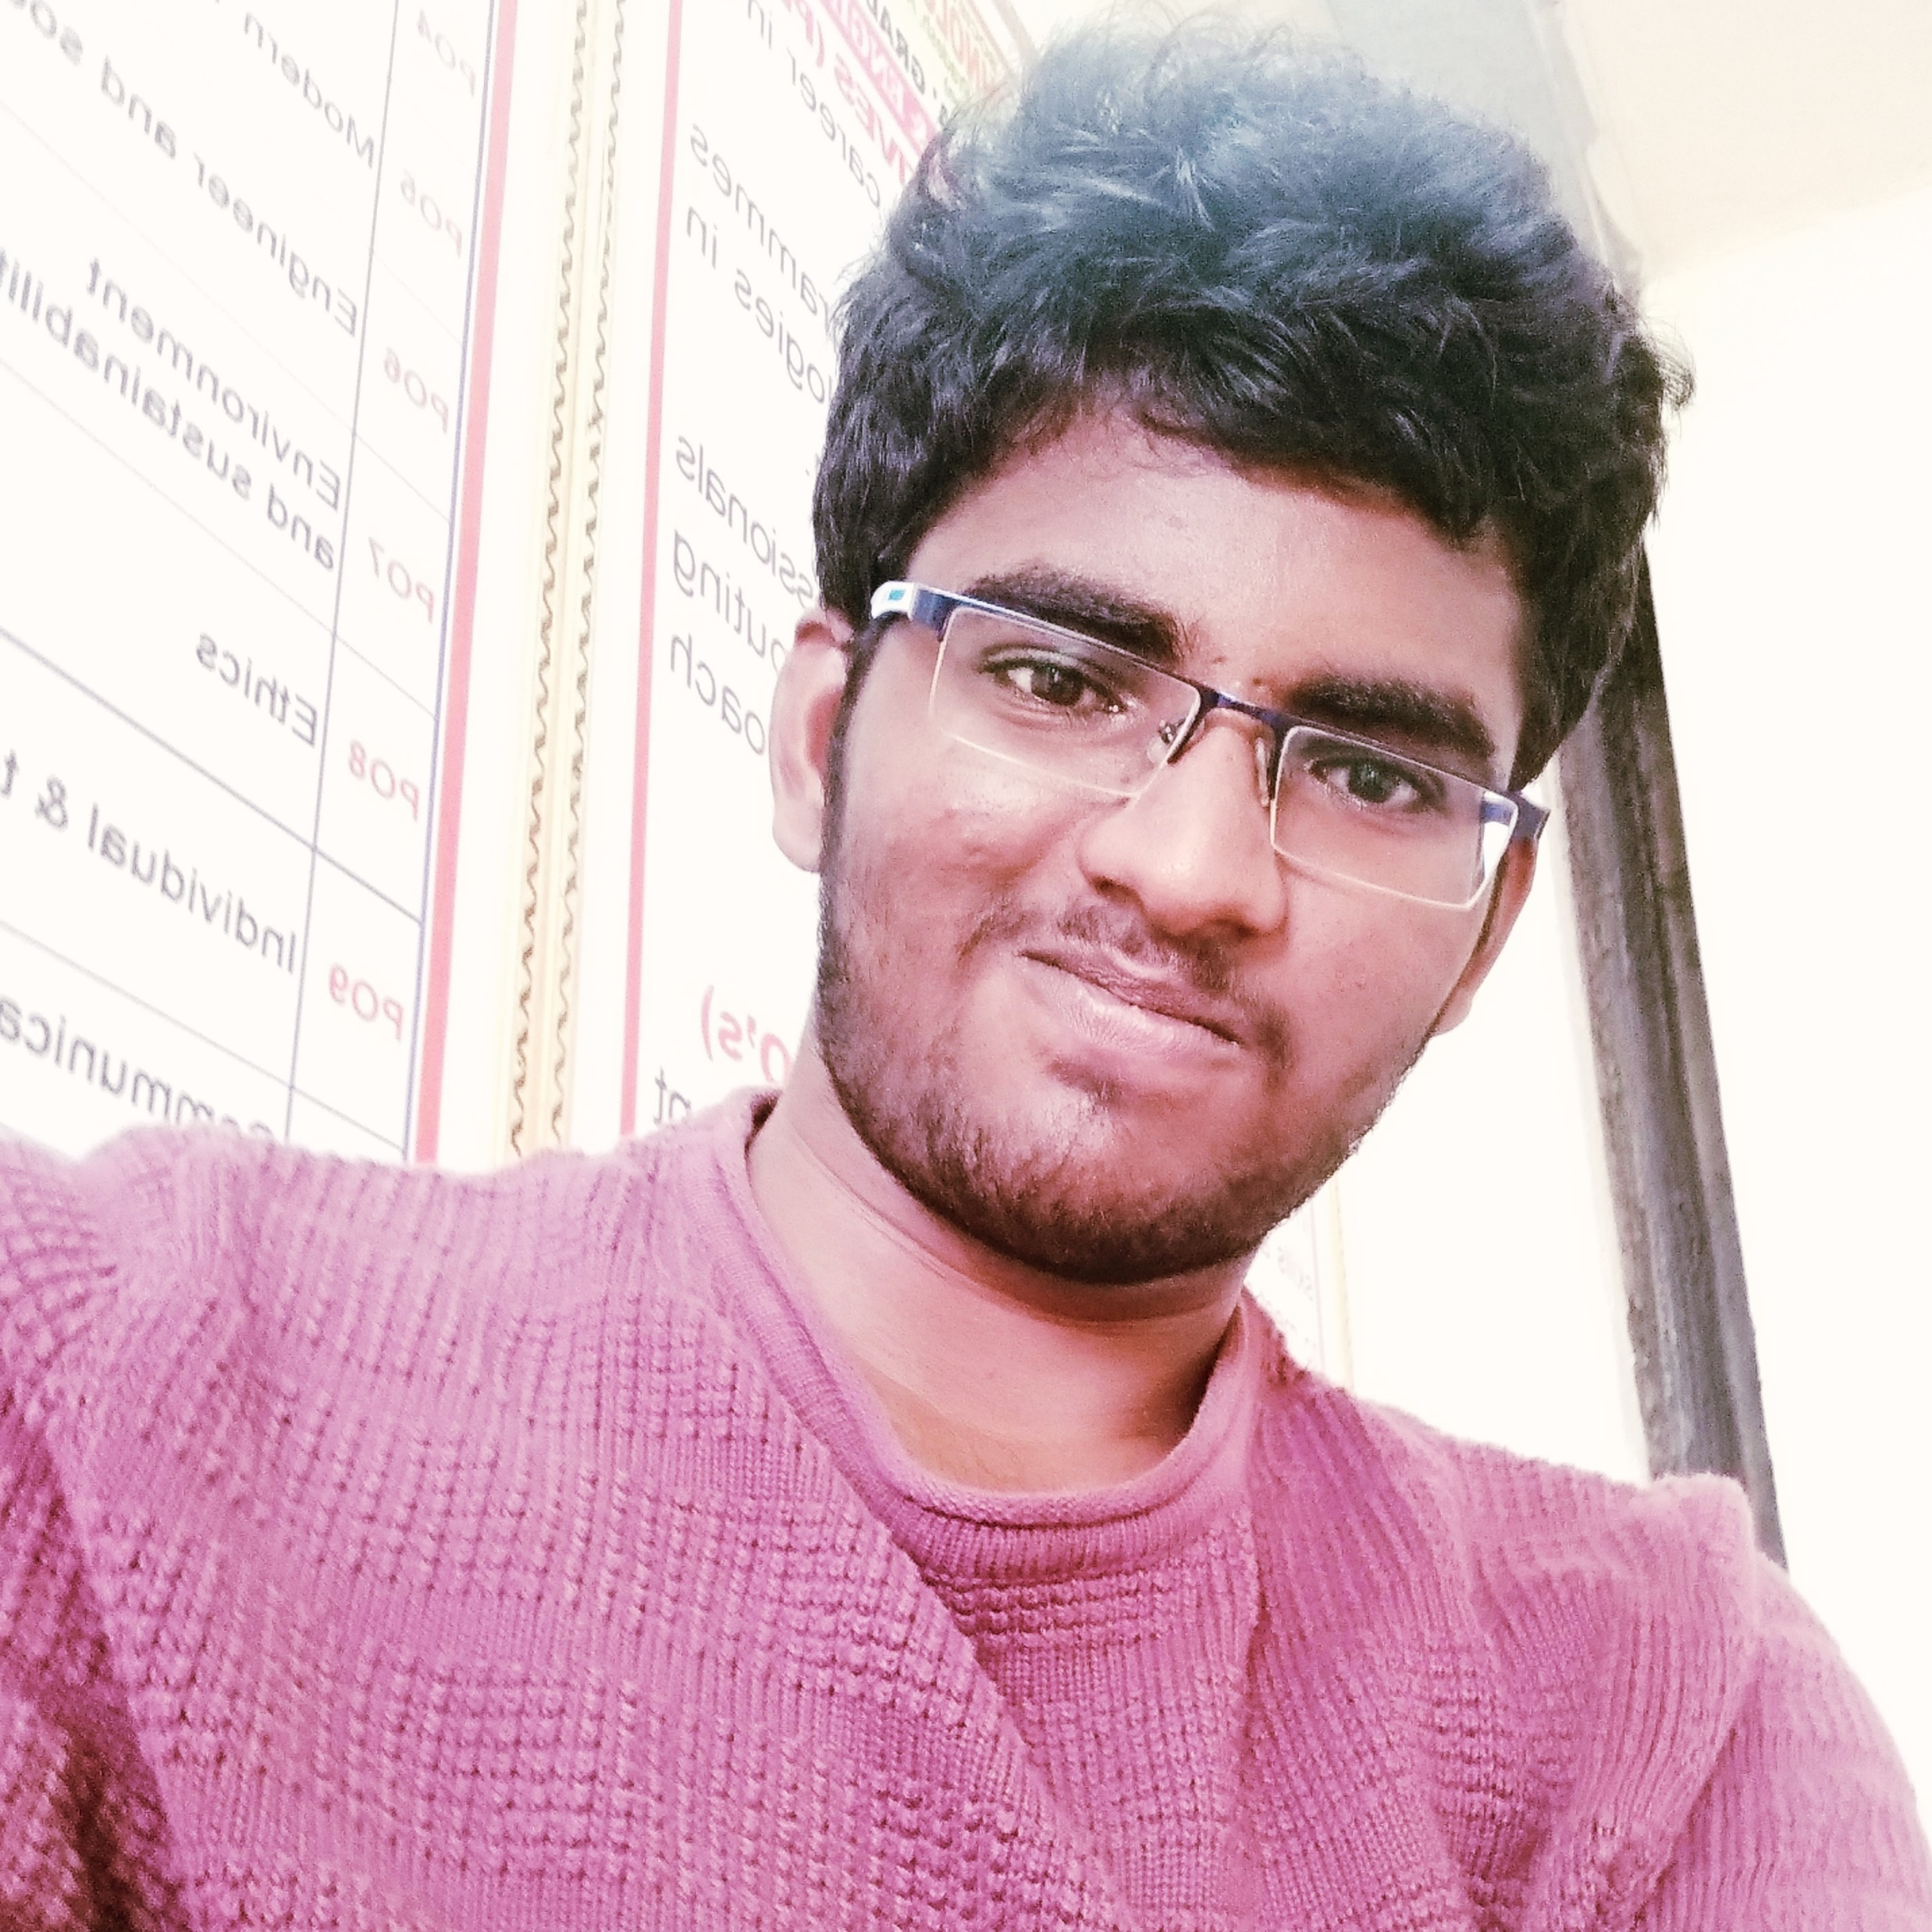

Indicative Profile – Java developer
Projects and Proof Of Concepts :
Shopping Cart Application : Description : This application displays list of items that are available in the shop with the user having ADMIN role can add products into shop other's can only shop , after carting the items the user is notified with an email in response.
Role : Java Developer
Designed the online shopping ecommerce experience web pages with JSP
Applied usage of proper associations between entities and cascade settings.
DAO classes: Usage of appropriate API methods for CRUD operations.
Usage of appropriate queries.
Exception Handling: Funneling of exceptions across the layers and displaying appropriate messages to the user .
Proper Maven dependency used.
Spring data repository interfaces used.
OrderMyFood (OMF) : Description : It facilitate their customers to create following services:
1.Restaurant Search Service:In this service, customer can search for the restaurants , 2.Order Management Service:This service will take care of placing order, updating order, cancelling order, view order and calculating the total food price based on the food ordered. Role : Java Developer
Communicating between microservices using Feign Client
Applied proper package structure (Controller,Interface,Service,Repository) using SpringBoot.
Applied proper usage of REST APIs(Rest methods, query parameters etc)
Built Unit Testing with Junit and Mockito .
Achieved Code quality and code coverage with Jacoco .
Service Discovery/Registration using Eureka .
Properly Used Circuit Breaker.
Sesharao Paritala
Java Full Stack Engineer
Technical Skills:
Spring Boot,Java OOPs, Spring Security, SQL, HTML, Jquery, Spring Microservices ,Bootstrap,
Java 8, Angular ,Ionic
Strengths:
Experience in working with API endpoints through RESTful services.
Experience in spring boot JPA , MVC application development.
Experience in implementing Java 8 features , through out application.
Experience in angular and Ionic frameworks
Experience in developing front end JSP pages through HTML , Jquery.
Experience in Junit and Mockito unit testing .
Trainings and Certifications :
i)Spring Boot Hands-on Lab 201
ii)RESTful Services With Jersey 201
iii)Spring Boot Microservices with Spring Cloud 201
iv)Secure Delivery for Java Developers 201

